Slide 1
CECS 326 Operating Systems
Overview
(Chapter 1, Operating system Concepts by Silberschatz, Galvin and Gagne)

Slide 2
What is an Operating System?
A program that acts as an intermediary between a user of a computer and the computer hardware
Operating system goals:
Execute user programs and make solving user problems easier
Make the computer system convenient to use
Use the computer hardware in an efficient manner

Slide 3
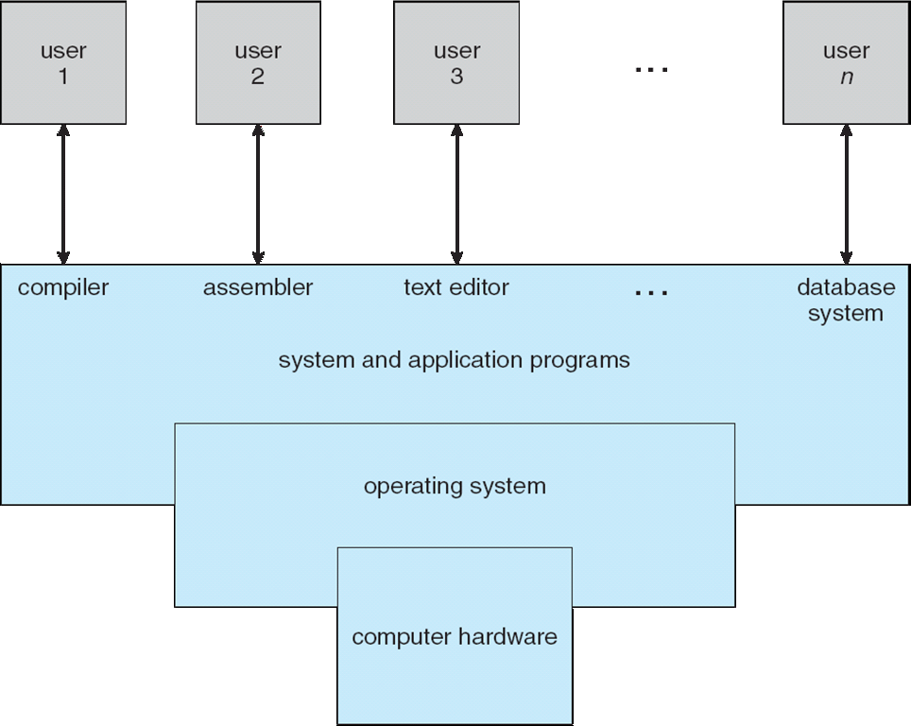
Computer System Structure
Consists of 4 components:
Hardware – provides basic computer resources (e.g., CPU, memory, I/O devices)
Operating system – controls and coordinates use of hardware among various applications
Applications – define the ways in which the system resources are used to solve the computer problems of the users (e.g., word processors, compilers, web browsers, database systems, video games)
Users – people, machines, other computers

Slide 4
What Do Operating Systems Provide?
Depends on the point of view
Users want convenience, ease of use, and good performance. Don’t care about resource utilization
Shared computers such as mainframe and minicomputers must keep all users happy
Dedicated systems such as workstations have dedicated resources but frequently use shared resources from servers
Handheld computers are resource poor, need to be optimized for usability and battery life
Some computers have little or no user interface, e.g., embedded computers in devices and automobiles

Slide 5
Operating System Definition
No universally accepted definition
Some view it as a resource allocator
Manages all resources
Decides between conflicting requests for efficient and fair use of resources
Others view it as a control program
Controls execution of programs to prevent errors and improper use of the computer
The part of OS running at all times on the computer is the kernel
The remaining parts of the OS are referred to as a system programs

Slide 6
What happens at Computer Startup
Bootstrap program is loaded at power-up or reboot
Typically stored in ROM or EPROM, generally known as firmware
Initializes all aspects of system, including CPU registers, device controllers, and memory contents
Loads operating system kernel and starts execution
Some system programs can also be loaded at boot time to become system processes of system daemons
Once system is fully booted, it can start providing services in response to events signaled by interrupts to the CPU from hardware or software

Slide 7
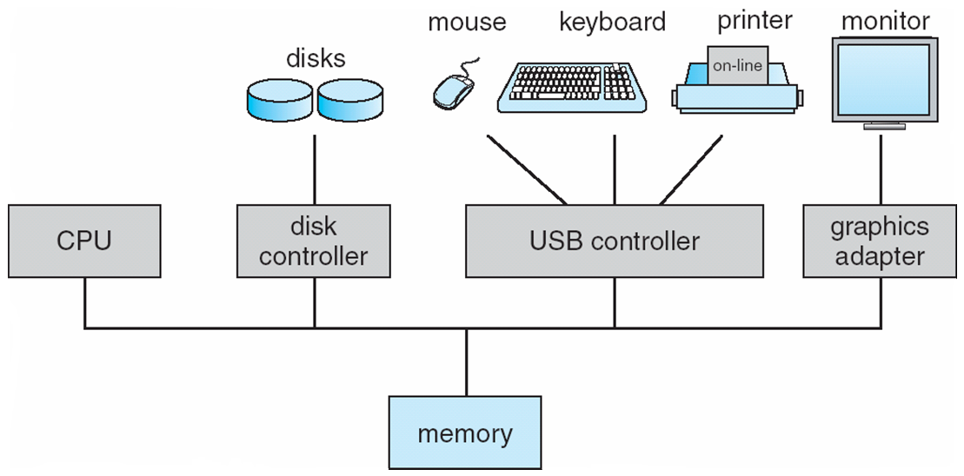
Computer System Organization
One of more CPUs, device controllers connect through common bus providing access to shared memory
Concurrent execution of CPUs and devices competing for memory cycles

Slide 8
Computer System Operation
I/O devices and the CPU can execute concurrently
Each device controller is in charge of a particular device type
Each device controller has a local buffer
CPU moves data from/to main memory to/from local buffers
I/O is from the device to local buffer of controller
Device controller informs CPU that it has finished its operation by causing an interrupt

Slide 9
Interrupts and Interrupt Handling
When CPU is interrupted, it stops what it is doing and immediately transfers execution to an interrupt service routine (interrupt handler) generally, through the interrupt vector, which contains the addresses of all the service routines
Interrupt architecture must save the address of the interrupted instruction so that interrupted computation can resume upon completion of the interrupt service routine
A trap or exception is a software-generated interrupt caused either by an error or a user request
Operating systems are interrupt driven
OS preserves state of CPU by storing registers and program counter
Determines which type of interrupt has occurred through polling of a vectored interrupt system
Different code performed action defined for different type of interrupt

Slide 10
Storage Structure
Main memory – the only large storage media that CPU can access directly
Random access
Typically volatile
Secondary storage – extension of main memory that provides large nonvolatile storage capacity
Hard disks – rigid metal or glass platters covered with magnetic recording material
Disk surface logically divided into tracks, which are subdivided into sectors
Disk controller determines the logical interaction between the device and the computer
Solid-state disks – faster than hard disks, nonvolatile
Various technologies
Becoming more popular

Slide 11
Storage Hierarchy
Storage systems are organized in hierarchy
Speed
Cost
Volatility
Caching – copying information into faster storage system
An important principle used at many levels (hardware, software, operating system)
Information in use is copied from slower to faster storage temporarily
Faster storage (cache) is checked first to determine if information is there; use from there if yes, otherwise data is copied to cache and used there
Cache is smaller than storage being cached
Cache management is an important design problem
Need to consider cache size and replacement policy
Device driver for each device controller to manage I/O to provide uniform interface between controller and kernel

Slide 12
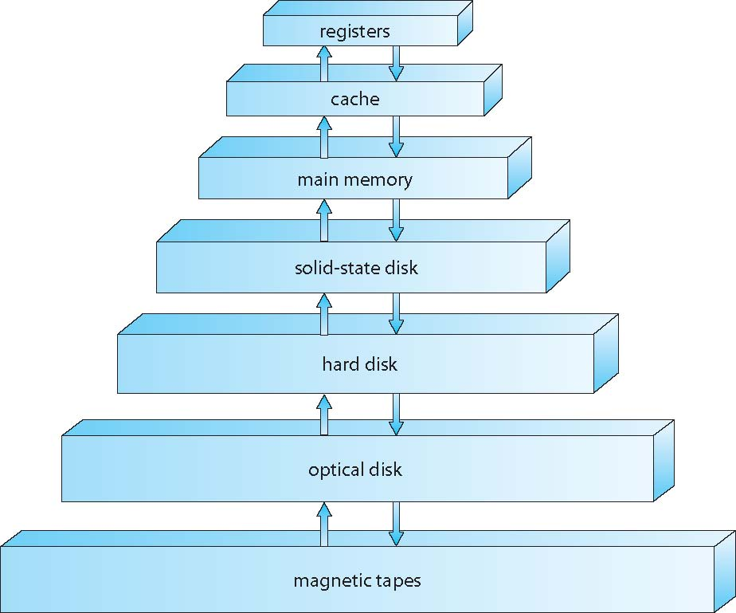
Storage Device Hierarchy

Slide 13
Performance of Various Levels of Storage
Movement between levels of storage hierarch can be explicit or implicit

Slide 14
Storage Definitions and Notation Review
The basic unit of computer storage is the bit. A bit can contain one of two values, 0 and 1. All other storage in a computer is based on collections of bits. Given enough bits, it is amazing how many things a computer can represent: numbers, letters, images, movies, sounds, documents, and programs, to name a few. A byte is 8 bits, and on most computers it is the smallest convenient chunk of storage. For example, most computers don’t have an instruction to move a bit but do have one to move a byte. A less common term is word, which is a given computer architecture’s native unit of data. A word is made up of one or more bytes. For example, a computer that has 64-bit registers and 64-bit memory addressing typically has 64-bit (8-byte) words. A computer executes many operations in its native word size rather than a byte at a time.
Computer storage, along with most computer throughput, is generally measured and manipulated in bytes and collections of bytes.
A kilobyte, or KB, is 1,024 bytes
a megabyte, or MB, is 1,024² bytes
a gigabyte, or GB, is 1,024³ bytes
a terabyte, or TB, is 1,024⁴ bytes
a petabyte, or PB, is 1,024⁵ bytes
Computer manufacturers often round off these numbers and say that a megabyte is 1 million bytes and a gigabyte is 1 billion bytes. Networking measurements are an exception to this general rule; they are given in bits (because networks move data a bit at a time).

Slide 15
Direct Memory Access (DMA) Structure
Used for high-speed I/O devices able to transmit data at close to memory speeds
Device controller transfers blocks of data from buffer storage directly to main memory without CPU intervention
Only one interrupt is generated per block, rather than one interrupt per byte

Slide 16
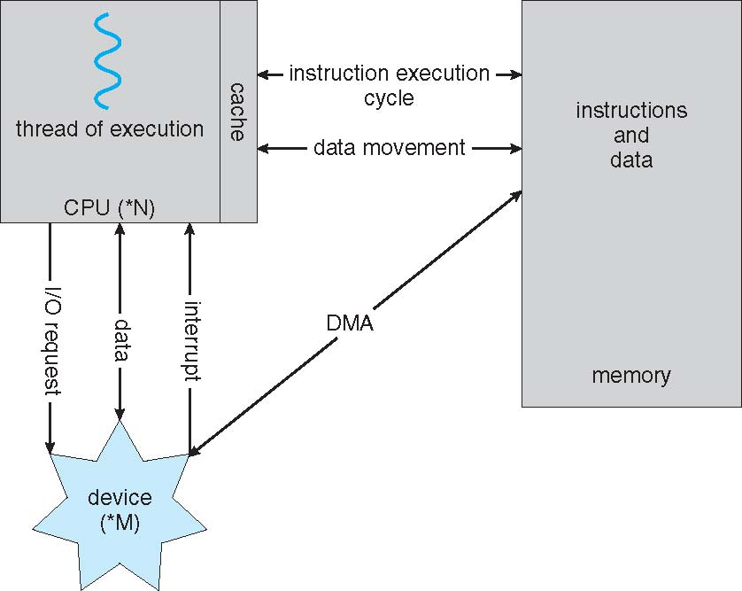
How a Modern Computer Works
A von Neumann Architecture

Slide 17
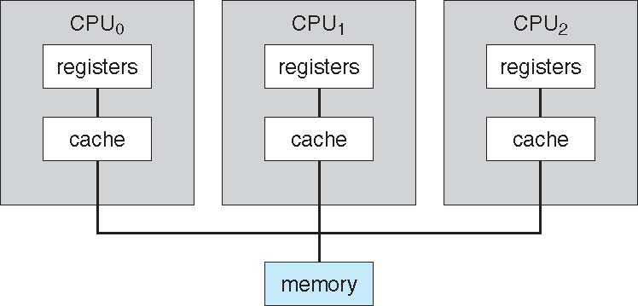
Multiprocessor Systems
Growing in use and importance
Advantages include:
Increased throughput
Economy of scale
Increased reliability, providing graceful degradation or fault tolerance

Slide 18
Clustered Systems
Like multiprocessor systems, but multiple computers working together
Usually sharing storage via a storage area network (SAN)
Provides high-availability service which survives failures
Some clusters are for high-performance computing (HPC)
Applications must be written to use parallelization
Some have distributed lock manager (DLM) to avoid conflicting operations

Slide 19
Operating System Operations
Interrupt driven (hardware and software)
Hardware interrupt by one of the devices
Software interrupt (exception or trap)
Software error (e.g., division by zero) and other process problems (e.g., processes modifying each other or the OS)
Request for OS service
Dual mode operation allows OS to protect itself and other system components
User mode and kernel mode
Mode bit provided by hardware
Provides ability to distinguish when system is running user code or kernel code
Some instructions designated as privileged, only executable in kernel mode
System call changes mode to kernel, return from call resets it to user mode
Some CPUs support multi-mode operations (e.g., virtual machine mode, or VMM, used for virtualization management software)

Slide 20
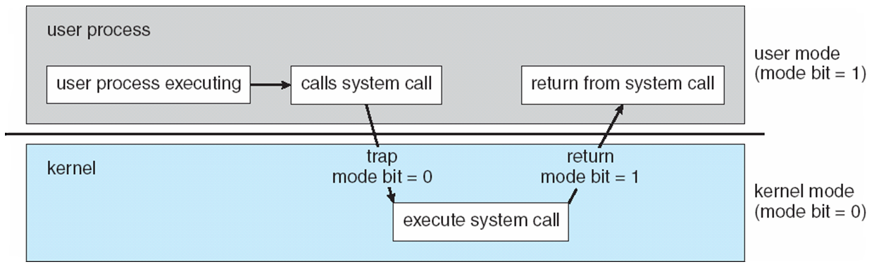
Transition from User to Kernel Mode
Timer is used to prevent infinite loop or process hogging resources
Timer is set to interrupt the computer after some time period, which can be fixed or variable. Instruction that modifies timer is privileged.
Variable timer usually implemented with a fixed-rate clock and a counter
Counter is decremented at each clock tick, interrupt when zero
Timer is set up before turning control to a user process
When timer interrupts, control transfers automatically to the OS

Slide 21
Process Management
A process is a program in execution. It is a unit of work that the OS manages. Program is a passive entity, process is an active entity.
Process needs resources to accomplish its task (CPU, memory, I/O, files, initialization data)
Process termination requires reclaim of all reusable resources
Single-threaded process has one program counter specifying address of next instruction to execute
Process executes instructions sequentially, one at a time, until completion
Multi-threaded process has one program counter for each thread
Typically system has many processes, some user and some OS, running concurrently on one or more CPUs
Concurrency by multiplexing the CPUs among the processes/threads

Slide 22
Process Management Activities
OS is responsible for the following activities in connection with process management
Creating and deleting both user and system processes
Suspending and resuming processes
Providing mechanisms for process synchronization
Providing mechanisms for process communication
Providing mechanisms for deadlock handling

Slide 23
Memory Management
To execute a program, all (or part) of the instructions and needed data must be in memory
Memory management determines what is in memory, where and when
Purpose is to optimize CPU utilization and computer response to users
Memory management activities
Keeping track of which parts of memory are currently being used and by whom
Deciding which processes (or part thereof) and data to move into and out of memory
Allocating and deallocating memory space as needed

Slide 24
Information and Storage management
OS provides uniform, logical view of information storage
Abstract physical properties to logical storage unit – file
Each medium is controlled by device (e.g., disk drive, tape drive)
Varying properties include access speed, capacity, data transfer rate, access method (sequential or random)
File system management
Files usually organized into directories
Access control on most systems to determine who can access what
OS activities include
Creating and deleting files and directories
Primitives to manipulate files and directories
Mapping files onto secondary storage
Backup files onto stable (non-volatile) storage media

Slide 25
Storage Management
Mass-storage management
Disks usually used to store data that does not fit in main memory (virtual memory) or for long-term storage
Proper management is of central importance
Entire speed of computer operation hinges on disk subsystem and its efficiency
OS activities
Free-space management
Storage allocation
Disk scheduling
Some storage need not be fast
Tertiary storage includes optical storage, magnetic tape
Still must be managed – by OS or applications
Varies between WORM (write-once, read-many-times) and RW (read-write)

Slide 26
I/O Subsystem
One purpose of OS is to hide peculiarities of hardware devices from the user
I/O subsystem is responsible for
Memory management of I/O including buffering (storing data temporarily while it is being transferred), caching (storing parts of data in faster storage for performance), spooling (e.g., print spooling)
General device-driver interface
Drivers for specific hardware devices

Slide 27
Protection and Security
Protection – any mechanism for controlling access of processes or users to resources defined by the OS
Security – defense of the system against internal and external attacks
Huge range, including denial-of-service, worms, viruses, identity theft, theft of service
Systems generally first distinguish among users to determine who can do what
User identities (user IDs, security IDs) include name and associated number, one per user
User ID then associated with all files, processes of that user to determine access control
Group identifier (group ID) allows set of users to be identified and controls managed, then also associated with each process and file

Slide 28
Kernel Data Structures
Many similar to standard programming data structures (linked lists, stack, queue)
Singly linked list
Doubly linked list
Circular linked list

Slide 29
Kernel Data Structures
Binary search tree (left <= right)
Worst-case search performance is O(n)
Balanced binary search tree
Search performance is O(log n)

Slide 30
Kernel Data Structures
Hash function can create a hash map
Bitmap – string of n binary digits representing the status of n items
Linux data structures are defined in include files <linux/list.h>, <linux/kfifo.h>, <linux/rbtree.h>

